Slide 1




Medical Sensors
Blood Flow Quantification in the
Aorta from MRI
Students:
Amjad Khan
Natalia Herrera Murillo
Zafar Toshpulatov
Supervisor:
Dr. Alain Lalande
January 19, 2018

Slide 2


Table of Contents
Introduction
Methods
First Method
Second Method
Implementation
Results and Comparison
Conclusion
Blood Flow Quantification in the Aorta from MRI

Slide 3
Introduction
Pulse wave velocity (PWV) is a validated indicator for evaluating aortic stiffness over a certain arterial length.
PWV can be obtained non-invasively through cardiac magnetic resonance imaging (MRI).
The aim of this project is to analyze and compare two different MRI-based approaches of measuring PWV for blood flow quantification in aorta.
Blood Flow Quantification in the Aorta from MRI

Slide 4
Table of Contents
Introduction
Methods
First Method
Second Method
Implementation
Results and Comparison
Conclusion
Blood Flow Quantification in the Aorta from MRI

Slide 5
First Method
1
Study: Two parameters PWV along the entire aorta and distensibility in four specific points of this artery.
2
Subjects: patients with the Marfan syndrome and a group of healthy volunteers.
3
Measurement of changes in distensibility at 4 levels of the aorta and PWV along the entire aorta after b-blocker therapy, using MRI.

Slide 6
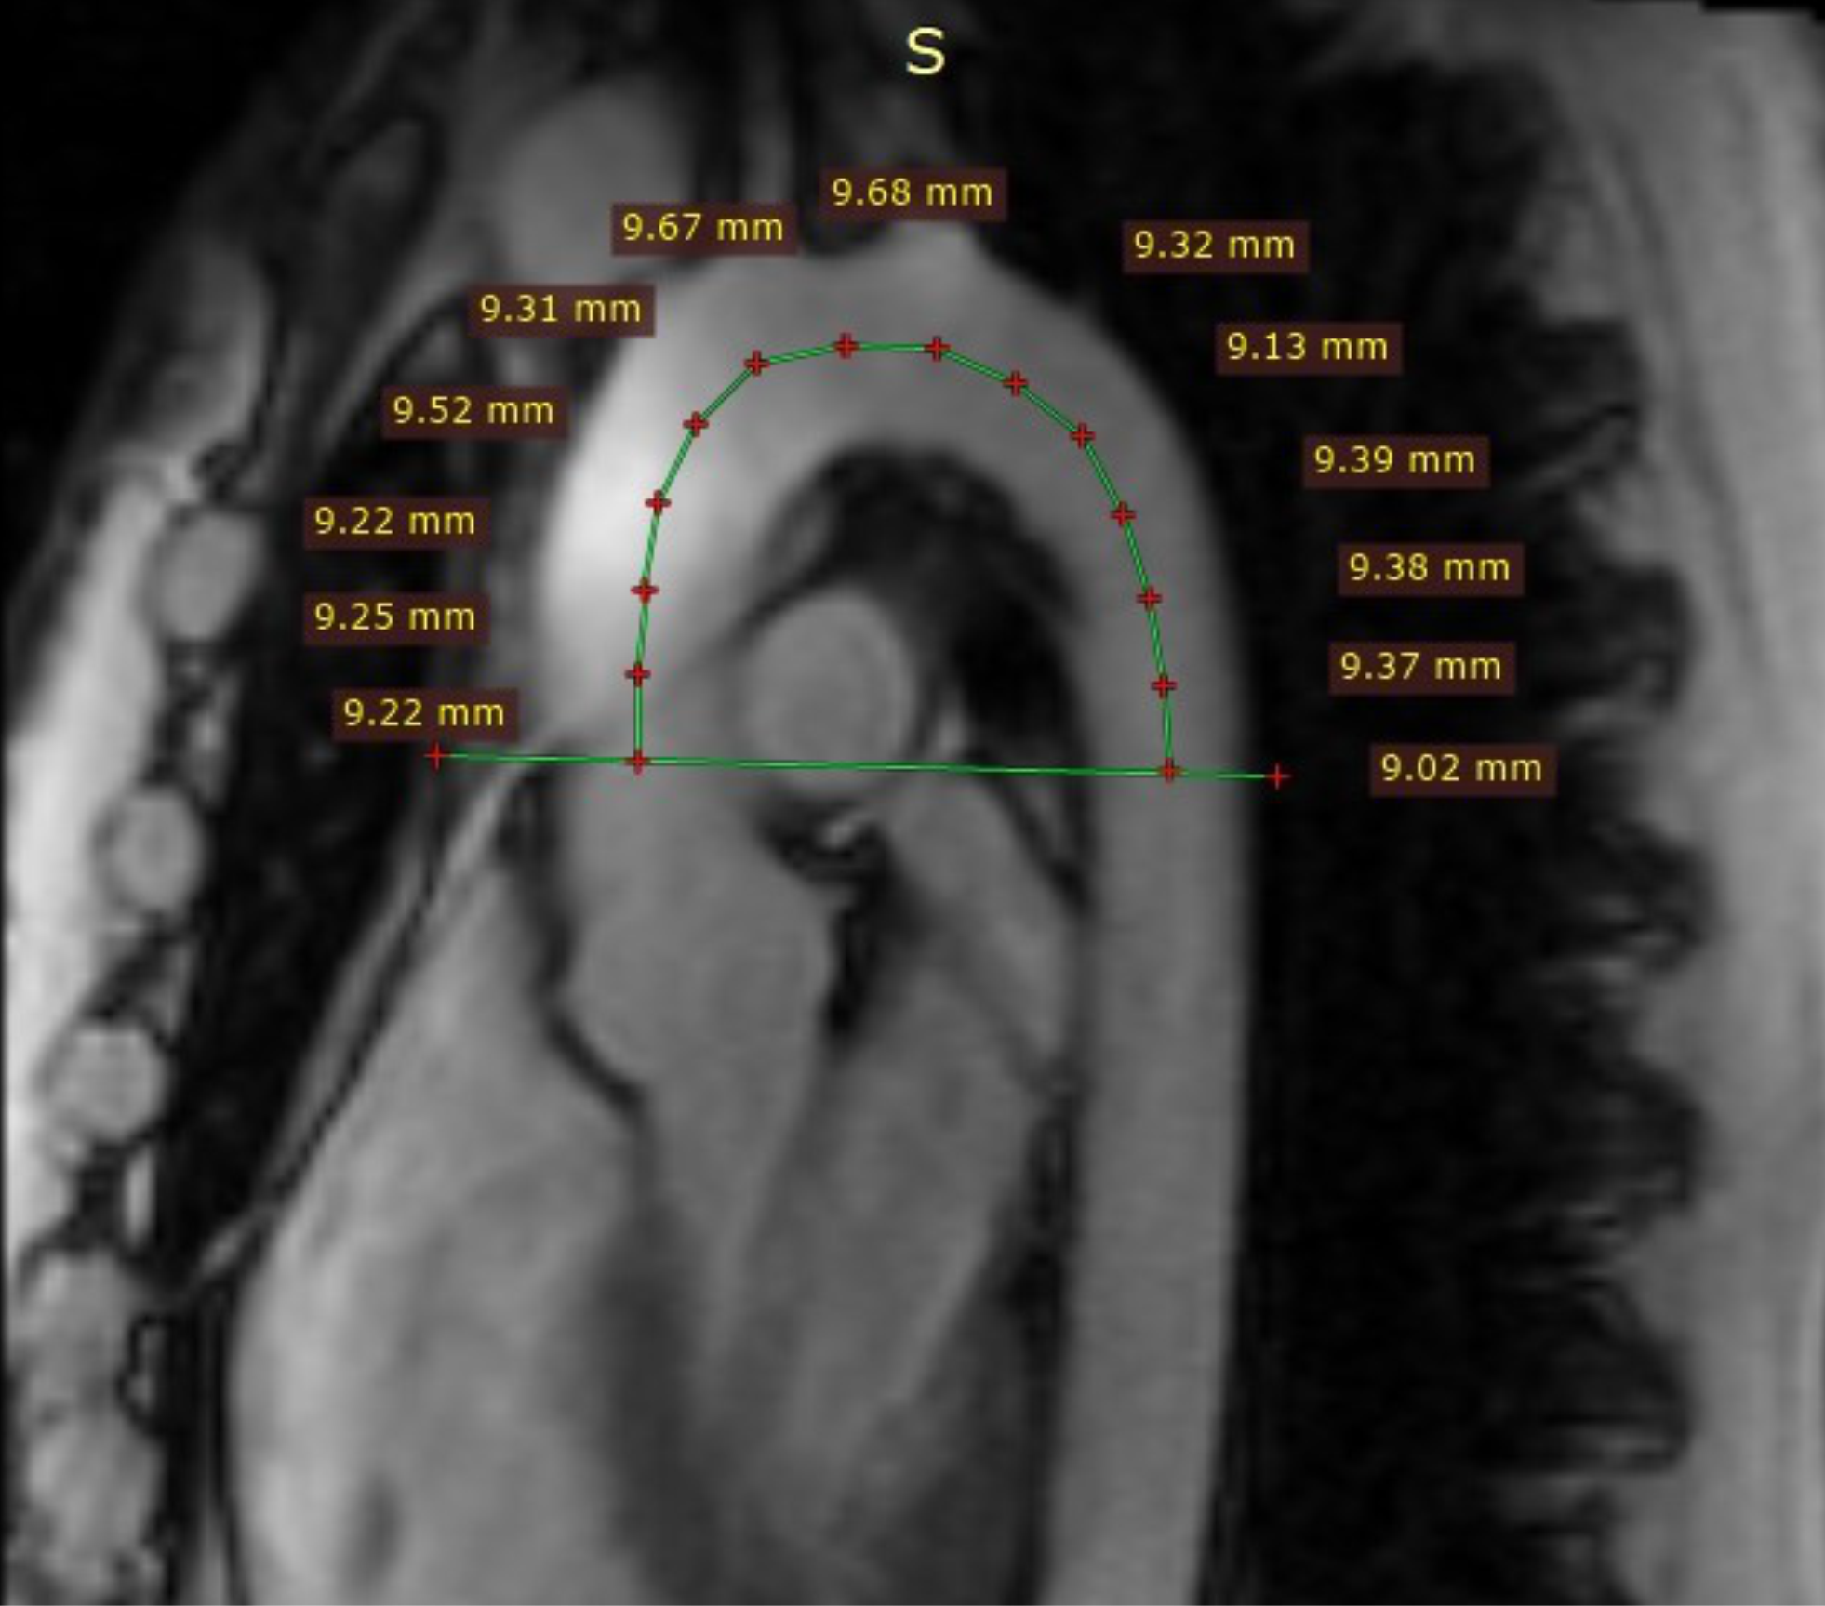
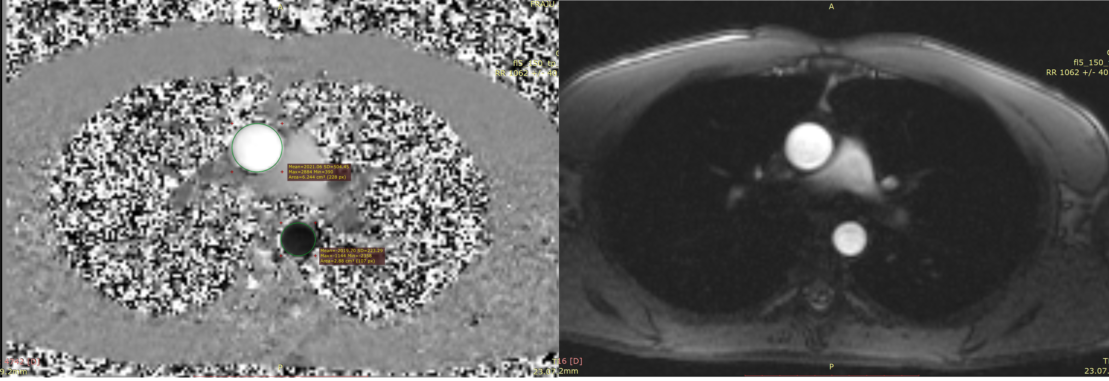
First Method
Figure 2: Velocity encoded image (left) and phase encoded image (right).
Figure 1: Manually measured segments for aortic arch length calculation
Blood Flow Quantification in the Aorta from MRI

Slide 7
Table of Contents
Introduction
Methods
First Method
Second Method
Implementation
Results and Comparison
Conclusion
Blood Flow Quantification in the Aorta from MRI

Slide 8
Second Method
1
Study: Three parameters aortic compliance, aortic distensibility and PWV.
2
Subjects: young asymptomatic individuals with mutation of the smooth
muscle myosin heavy chain
3
All three parameters were measured semi-automatically from MRI data.
Blood Flow Quantification in the Aorta from MRI

Slide 9
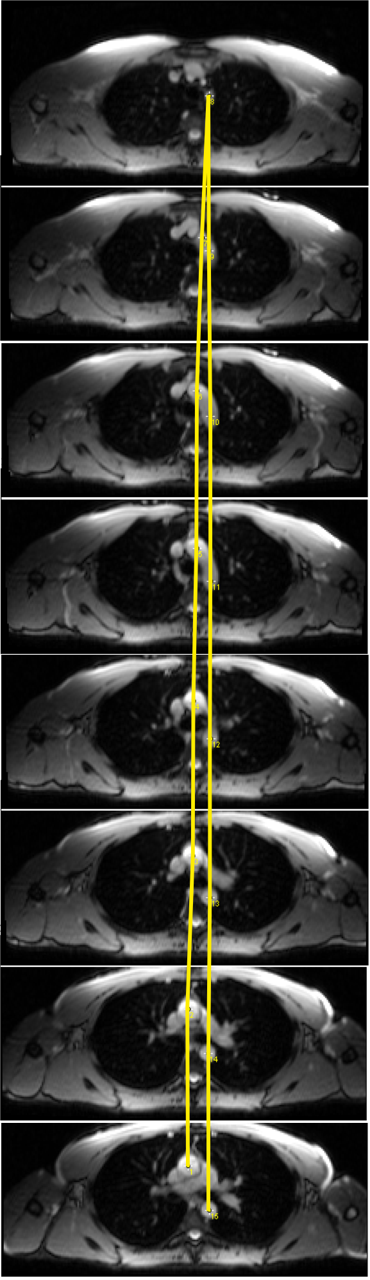
Second Method
Figure2: Velocity encoded image (left) and phase encoded image (right).
Figure 3: Indicated points of centers of the aortic regions for aortic arch length
Blood Flow Quantification in the Aorta from MRI

Slide 10
Table of Contents
Introduction
Methods
First Method
Second Method
Implementation
Results and Comparison
Conclusion
Blood Flow Quantification in the Aorta from MRI

Slide 11
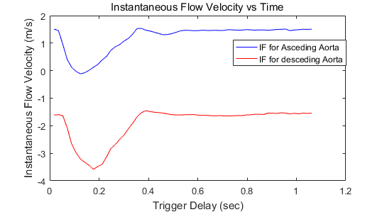
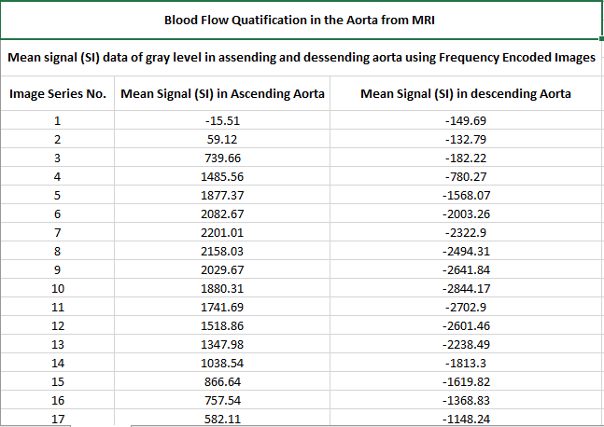
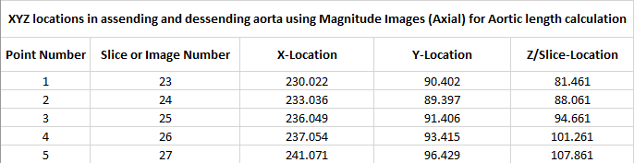

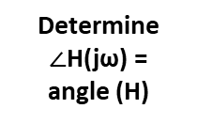

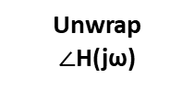


Calculation of PWV
Get contours in the two ROI
Get SI within each ROI
Calculate IF in x(t) and y(t)
IF(m.s-1) = ((NV-SI) x MV)/NV (1)
IF(m.s-1) = ((SI-NV) x MV)/NV (2)
(1) x(t) → IF for ascending aorta
(2 ) y(t) → IF for descending aorta
Calculation of Δt
Calculate FFT for x(t) and y(t)
Determine H(jω) = Y(jω)/X(jω)
Determine $∠$H(jω) =
angle (H)
Get GD = $\frac{−d∠H(jω)}{dω}$
x(t) →W(jω)
y(t) → Y(jω)
Calculate Δt =
$$\frac{{|X|}^{2}∗GD}{\sum{{|X|}^{2}}}$$
Unwrap
$∠$H(jω)
Mag H(jω) = angle (H)
A
B
Manually get center points
x and y
Manually place the segments to measure
AL along a midline through aortic arch
Get z = slice orientation
Calculation of AL
Get each segment length (SL)
Calculate AL =
$$\sum_{i}^{n}{{(SL}_{i})}$$
$$AL=$$
$$\sum_{i=1}^{n}{\sqrt{{\left.{\left(x_{i }−(x_{i }+1)\right)}^{2} {\left(z_{i }−(z_{i }+1)\right)}^{2}+(y_{i }−(y_{i }+1)\right)}^{2}}}$$
PWV= 𝐴𝐿/𝛥𝑡

Slide 12
Tools
Methods were implemented successfully using the following analysis software:
MATLAB
Transformation of input and output signals into frequency domain using FFT
RadiAnt
DICOM Viewer
Contours generation in aortic regions
Extraction of (x, y) points in calculation of length of aortic arch
ImageJ
Blood Flow Quantification in the Aorta from MRI

Slide 13
Table of Contents
Introduction
Methods
First Method
Second Method
Implementation
Results and Comparison
Conclusion
Blood Flow Quantification in the Aorta from MRI

Slide 14

Comparision
A
B
PARAMETERS
FIRST METHOD
SECOND METHOD
Aortic arch length
(AL,mm)
121.30
125.12
Transit Time
(Δt,ms)
34.30
34.30
Pulse wave velocity
(PWV, m.s⁻¹)
3.5382
3.6497
Blood Flow Quantification in the Aorta from MRI

Slide 15
Table of Contents
Introduction
Methods
First Method
Second Method
Implementation
Results and Comparison
Conclusion
Blood Flow Quantification in the Aorta from MRI

Slide 16
Conclusions
In this project, two different methods to measure PWV in the aortic region using MRI have been studied.
Both methods have been implemented successfully.
The analysis showed that almost identical parameters have been obtained in both methods.
Blood Flow Quantification in the Aorta from MRI

Slide 17
Thank you!
Blood Flow Quantification in the Aorta from MRI

